Slide 1
Quarterly Briefing
Atlanta City Council
Public Safety & Legal Administration Committee
February 27, 2023

Slide 2
Overview
PAD connects people to resources and support to effectively address needs related to substance use, mental health and extreme poverty, and resolve quality-of-life and public order concerns that arise from these needs.
PAD provides:
Community first response through ATL311 for concerns related to substance use, mental health or extreme poverty
Direct services and navigation support for people diverted by law enforcement or with open cases related to these same concerns
Community engagement and education to expand residents' utilization of this alternative approach
Notes:
2
2
2
2

Slide 3
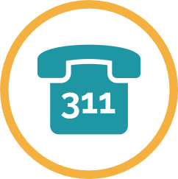
2022 Impact
359
Pre and post booking diversions, including re-referrals
1,321
Community referrals through ATL311
582
Individuals currently enrolled in Care Navigation Services
1,661
Businesses engaged through in-person outreach
Notes:
3
3
3
3

Slide 4
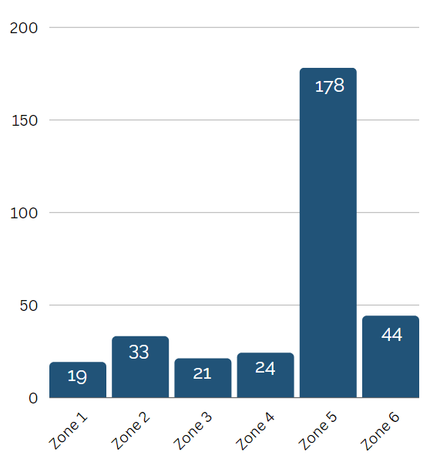
2022 Diversions
DIVERSIONS BY ZONE
331 APD DIVERSIONS
Compared to 266 people in 2021
TOP DIVERTED CHARGES
Criminal Trespass
Panhandling
Shoplifting
Public Intoxication
Disorderly Conduct
Notes:
– Average response time 20 minutes
4

Slide 5
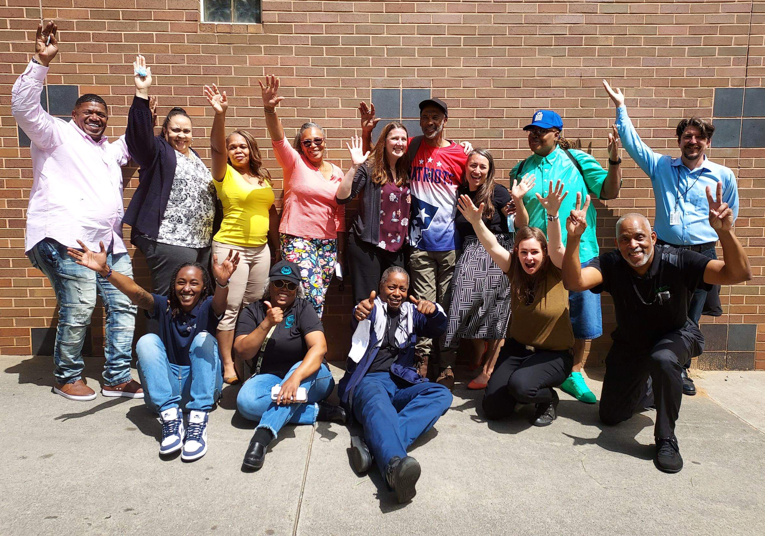
The Center for Diversion & Services
In 2022, PAD participated in the Center for Diversion & Services planning by:
Serving as the contracting agency for Architecture & Design, supported by the Microsoft Justice Reform Initiative
Participating in the Justice Policy Board to develop protocol recommendations
Co-hosting three community design sessions, including programming and public art
Conducted a public survey on programming needs at the Center
Notes:
5

Slide 6
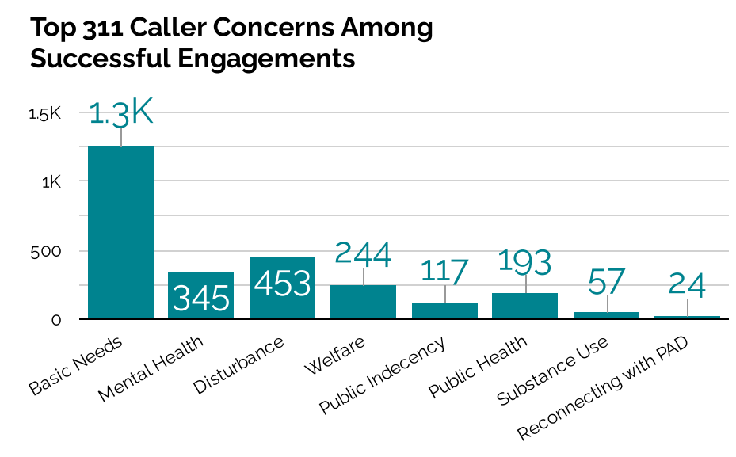
2022 Community Response Services
1,321 COMMUNITY REFERRALS THROUGH ATL311 Excludes duplicate and ineligible calls
1,091 referrals
(83% of all calls) were designated as an immediate response.
21 minutes
AVERAGE RESPONSE TIME
Notes:
6

Slide 7
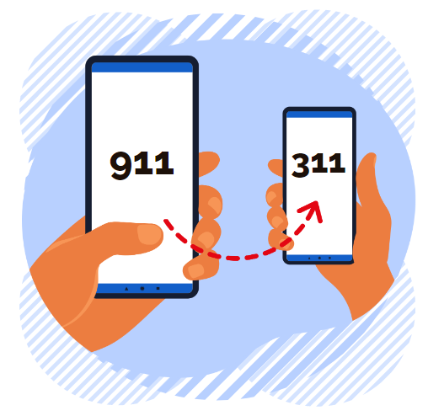
911 Call Deflection Pilot
In 2022, we worked with 911 and 311 to pilot one call code to deflect from 911 to 311 for PAD.
In 2023 we will add additional call codes.
Launch date: October 17th
Call transfers in 2022: 24 for public indecency
Notes:
7

Slide 8
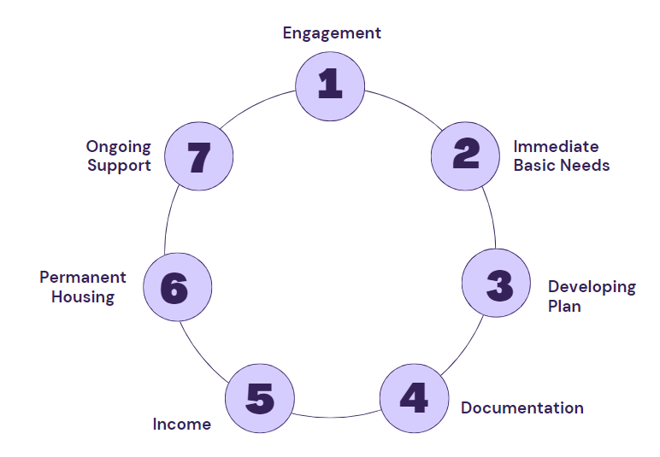
2022 Care Navigation
382 new individuals provided direct services to address immediate basic needs, and navigation to healthcare, benefits, recovery support, employment and housing.
Notes:
PAD provides support to participants as long as the individual requires support, and includes – but is not limited to - substance use treatment, mental health care, housing placement, family reconnection, and job training and placement.
The majority of participants are Cis-Men, between the ages of 41-60, and Black
8

Slide 9
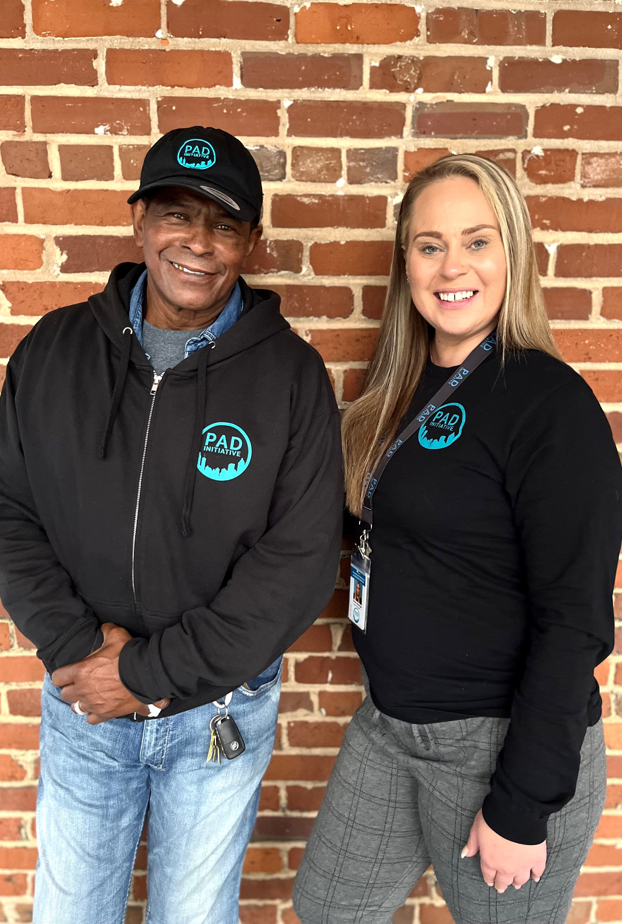
SWEET Teams Launch (Street Wellness Enhancement & Engagement Team)
PAD launched street-based intensive case management for people with severe mental illness who are unhoused, with dedicated bridge housing, supportive services, and housing
voucher placement through a partnership with Georgia DBHDD, Grady Hospital and Partners for
HOME.
45 participants provided bridge housing and supportive services
12 participants permanently housed through the Georgia Housing Voucher
Notes:
9

Slide 10
National Recognition
Diversion Center Planning
PAD selected as one of five national organizations by NFL's Social Justice Working Group, comprised of members of the Players Coalition and club owners, including Arthur Blank.
PAD selected as one of eight national organizations to join the Just Trust's Safer Communities Accelerator
Notes:
11

Slide 11
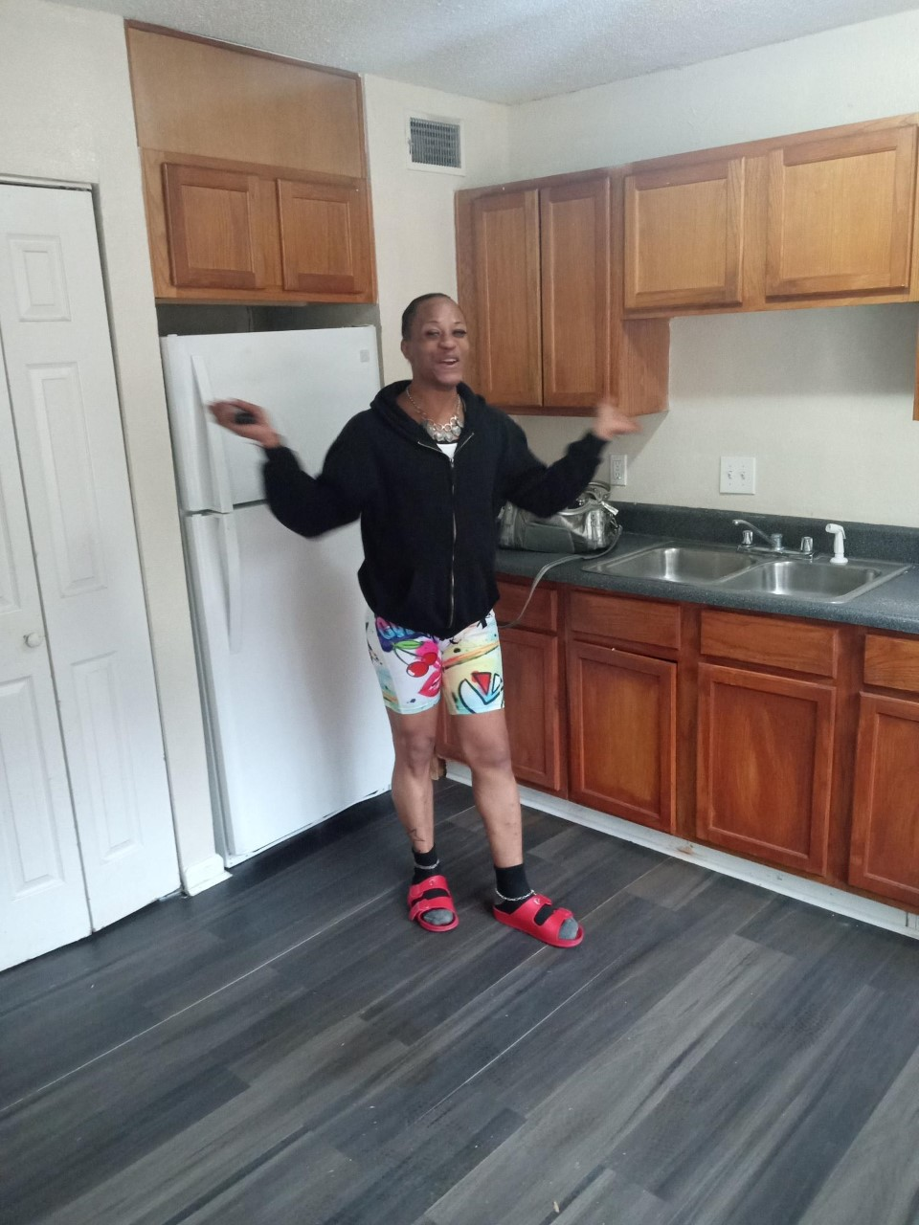
Testimonial
Diversion Center Planning
Brianna was referred to PAD by the Fulton County Public Defender’s Office in April of 2022 after numerous incarcerations related to unmet mental health concerns and substance misuse.
Working together with her PAD Care Navigator, Brianna met her treatment goals and was approved for the Georgia Housing Voucher in late 2022.
She started the new year moving into her own apartment and is now working in the hospitality industry.
Notes:
10

Slide 13
Local Recognition
Diversion Center Planning
Notes:
13

Slide 14
Diversion Center Planning
Looking Ahead
Law Enforcement training:
Focus on training most active officers
Academy trainings
Weekly roll-call visits
The Center for Diversion & Services:
Joint communications and community engagement with core partners
Justice Policy Board planning to establish protocols and programming
Collaboration with Fulton County to train other law enforcement agencies
Community Engagement:
Continued business engagement through canvassing
Neighborhood canvassing
Regular attendance at NPU, neighborhood, and business meetings
Community Leadership Team
Notes:
14

Slide 15
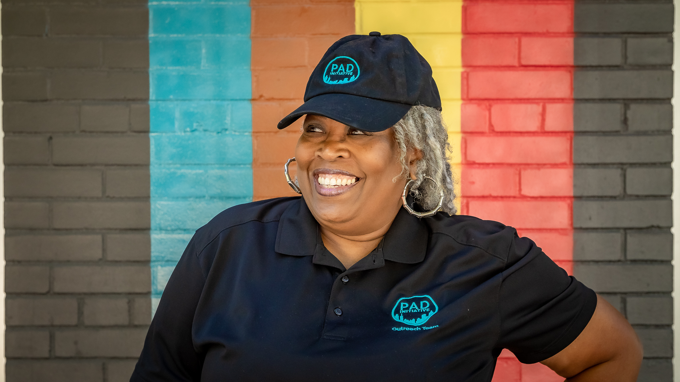
Thank you!
Diversion Center Planning
Notes:
15

